Slide 1
Superposition

Slide 2
Superposition Steps
Keep one independent source and turn off all other independent sources
  Replace current source with open circuit
  Replace voltage source with short circuit
Solve for desired values
Repeat for all independent sources
Output is equal to the sum of the each output caused by turning off all but one source

Slide 3
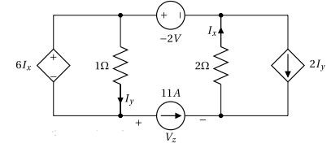
Example #1
Solve for Ix, Iy, and Vz using superposition method

Slide 4
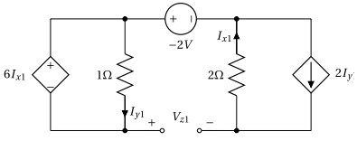
6 I_{x} = 1 * I_{y}
I_{x} = 2I_{y}
1. Turn off independent current source
2. Replace with open circuit
Since I_{x} and I_{y} are 0, there is no voltage drop across the resistors
I_{x} = 0 I_{y} = 0
V_{z} = -2V

Slide 5
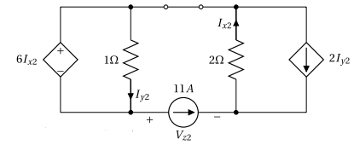
6 I_{x} = 1*I_{y}
2I_{x} + 1I_{y} + V_{z} = 0
11A + 2I_{y} = I_{x}
1. Turn off independent voltage source
2. Replace with short circuit
I_{x} = -1A I_{y} = -6A
Vz = 8V

Slide 6
I_{y} = I_{y} + I_{y} = 0 + (-6A) = -6A
I_{x} = I_{x} + I_{x} = 0 + (-1A) = -1A
V_{z} = V_{z} + V_{z} = (-2V) + (8V) = 6V

Slide 7
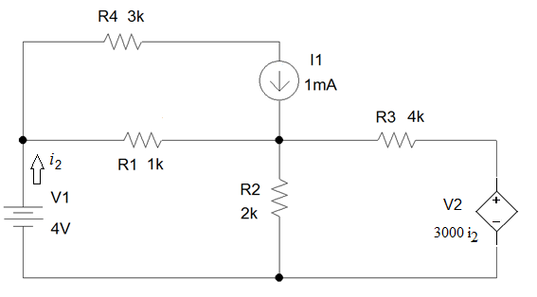
Example #2
Solve for V2 and I2
(just write the system of equations you would need to solve)

Slide 8
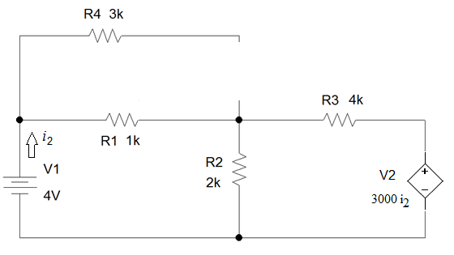
Turn I₁ off and replace with an open circuit

Slide 9
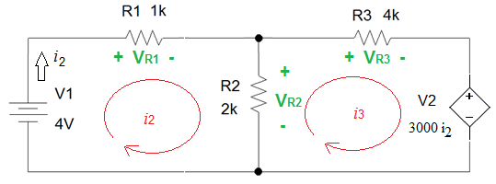
V₁ + V_{R1} + V_{R2} = 0
V_{R2} + V_{R3} + V₂ = 0
4V + i₂(1) + (i₂ – i₃)(2) = 0
(i₂ – i₃)(2) + i₃(4) + 3000i₂ = 0
i₂ = 1.2 mA i₃ = -0.2 mA v₂ = 3.6V

Slide 10
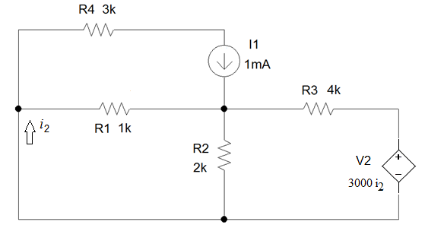
Turn off independent voltage source and replace with a short circuit

Slide 11
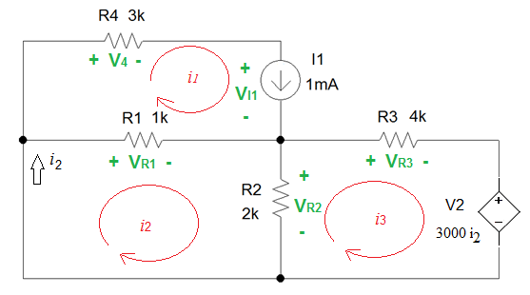
V_{R1} + V_{R2} = 0
V_{R2} + V_{R3} + V₂ = 0
V₄ + V_{I1} – V_{R1} = 0
(i₂ – 1mA)(1) + (i₂ – i₃)(2) = 0
-(i₂ – i₃)(2) + i₃(4) + 3000i₂ = 0
i₁(3) + V_{I1} – (i₂ – 1mA)(1) = 0
i₂ = 0.3 mA i₃ = -0.05 mA v₂ = 0.9V

Slide 12
i₂ = i₂ + i₂ = (1.2mA) + (0.3mA) = 1.5 mA
V₂ = V₂ + V₂ = (3.6V) + (0.9V) = 4.5V

